Slide 1
Classical Problems
Concurrent Programming CT074-3-2 Version 0120

Slide 2
Topic & Structure of The Lesson
Semaphores
Nested Monitors

Slide 3
Learning Outcomes
At the end of this topic, You should be able to
Describe how semaphores work
Discuss issues in nested monitors

Slide 4
Key Terms You Must Be Able To Use
If you have mastered this topic, you should be able to use the following terms correctly in your assignments and exams:
Semaphores
Nested Monitors

Slide 5
Learning Outcomes
At the end of this module, you should be able to do the following:
Explain and apply the fundamental concepts of concurrency in the design and construction of a concurrent system using Java application.
Discuss the safety aspects of multi threaded system
Discuss the need for encapsulation in concurrent systems

Slide 6
Learning Outcomes
At the end of this module, you should be able to do the following:
Discuss the concept of condition synchronisation.
Represent conditional synchronisation in Java.

Slide 7
Classical Problems
Concepts: monitors:
encapsulated data + access procedures
mutual exclusion + condition synchronization
single access procedure active in the monitor
nested monitors
Practice: private data and synchronized methods (exclusion).
wait(), notify() and notifyAll() for condition synch.
single thread active in the monitor at a time

Slide 8
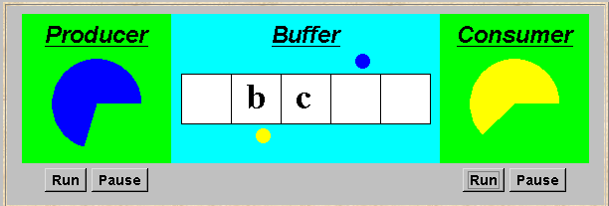
Bounded Buffer
A bounded buffer consists of a fixed number of slots. Items are put into the buffer by a producer process and removed by a consumer process. It can be used to smooth out transfer rates between the producer and consumer.
(see car park example)

Slide 9
bounded buffer program - buffer monitor
public interface Buffer <E> {…}
class BufferImpl <E> implements Buffer <E> {
…
public synchronized void put(E o)
throws InterruptedException {
while (count==size) wait();
buf[in] = o; ++count; in=(in+1)%size;
notifyAll();
}
public synchronized E get()
throws InterruptedException {
while (count==0) wait();
E o =buf[out];
buf[out]=null; --count; out=(out+1)%size;
notifyAll();
return (o);
}
}
We separate the interface to permit an alternative implementation later.
Is it safe to use notify() here rather than notifyAll()?
Notes:
Yes, since only 1 producer and 1 consumer thread..

Slide 10
Bounded buffer program - producer process
class Producer implements Runnable {
Buffer buf;
String alphabet= "abcdefghijklmnopqrstuvwxyz";
Producer(Buffer b) {buf = b;}
public void run() {
try {
int ai = 0;
while(true) {
ThreadPanel.rotate(12);
buf.put(alphabet.charAt(ai));
ai=(ai+1) % alphabet.length();
ThreadPanel.rotate(348);
}
} catch (InterruptedException e){}
}
}
Similarly Consumer which calls buf.get().

Slide 11
Semaphores
A semaphore s is an integer variable that can take only non-negative values. Once s has been given an initial value, the only operations permitted on s are up(s) and down(s) defined as follows:
down(s): when s>0 do decrement s;
up(s): increment s

Slide 12
Semaphores
down(s): if s>0 then
decrement s
else
block execution of the calling process
up(s): if processes blocked on s then awaken one of them
else
increment s

Slide 13
Semaphores in Java
Semaphores are passive objects that react to up and down actions; they do not initiate actions. Consequently, we implement a semaphore in Java as a monitor class. The actions up and down becomes synchronised methods.

Slide 14
Semaphores in Java
public class Semaphore {
private int value;
public Semaphore (int initial) {
value = initial;
}
synchronized public void up() {
++value;
notify();
}
synchronized public void down() throws InterruptedException {
while (value== 0) wait();
--value;
}
}

Slide 15
Nested Monitors
Suppose that we did not wish to use conditional synchronisation directly in the implementation of the buffer monitor class but instead we decided to use the semaphores full and empty to reflect the state of the buffer.
The semaphore empty counts the number of spaces and is decremented during a put operation. The put is, of course, blocked if the value of empty is zero. Similarly, full counts the number of items in the buffer and is decremented by a get operation. The get is therefore blocked if the value of full is zero.

Slide 16
Nested Monitors
Suppose that, in place of using the count variable and condition synchronization directly, we instead use two semaphores full and empty to reflect the state of the buffer.
class SemaBuffer <E> implements Buffer <E> {
…
Semaphore full; //counts number of items
Semaphore empty; //counts number of spaces
SemaBuffer(int size) {
this.size = size; buf =(E[])new Object[size];
full = new Semaphore(0);
empty= new Semaphore(size);
}
…
}

Slide 17
Pause

Slide 18
nested monitors - bounded buffer program
synchronized public void put(E o)
throws InterruptedException {
empty.down();
buf[in] = o;
++count; in=(in+1)%size;
full.up();
}
synchronized public E get()
throws InterruptedException{
full.down();
E o =buf[out]; buf[out]=null;
--count; out=(out+1)%size;
empty.up();
return (o); }
empty is decremented during a put operation, which is blocked if empty is zero; full is decremented by a get operation, which is blocked if full is zero.

Slide 19
nested monitors - bounded buffer model
analysis predicts a possible DEADLOCK:
The Consumer tries to get a character, but the buffer is empty. It blocks and releases the lock on the semaphore full. The Producer tries to put a character into the buffer, but also blocks. Why?
This situation is known as the nested monitor problem.

Slide 20
Nested Monitor Problem
When the consumer calls get, it acquires the Buffer monitor lock and then acquires the monitor lock for the full semaphore by calling full.down() to check if there is something in the buffer. Since initially the buffer is empty, the call to full.down() block the consumer thread (using wait()) and releases the monitor lock for the full semaphore. However, it does not release the monitor lock for Buffer. Consequently, the producer cannot enter the monitor to put a character into the buffer and so no progress can be made by either producer or consumer – hence the deadlock – nested monitor problem.

Slide 21
nested monitors - bounded buffer model
synchronized public Object get()
throws InterruptedException{
full.down(); // if no items, block!
...
}
get
down
full
full
full
buffer
buffer
wait
put
empty

Slide 22
Nested monitors - revised bounded buffer program
The only way to avoid it in Java is by careful design. In this example, the deadlock can be removed by ensuring that the monitor lock for the buffer is not acquired until after semaphores are decremented.
public void put(E o)
throws InterruptedException { empty.down();
synchronized(this){
buf[in] = o; ++count;
in=(in+1)%size; }
full.up();
}
Notes:
A synchronized instance method in Java is synchronized on the instance (object) owning the method. Thus, each instance has its synchronized methods synchronized on a different object: the owning instance.
http://tutorials.jenkov.com/java-concurrency/synchronized.html

Slide 23
synchronized method
acquires a lock on the whole object. This means no other thread can use any synchronized method in the whole object while the method is being run by one thread.

Slide 24
synchronized blocks
acquires a lock in the object between parentheses after the synchronized keyword. Meaning no other thread can acquire a lock on the locked object until the synchronized block exits.

Slide 25
So, if you want to lock the whole object, use a synchronized method.
If you want to keep other parts of the object accessible to other threads, use synchronized block.

Slide 26
Clarification!
Semaphores are NOT Nested Monitors
It is another way to ensure finite resources are utilized within its limitations

Slide 27
Summary
Concepts
monitors: encapsulated data + access procedures
mutual exclusion + condition synchronization
nested monitors
Practice
private data and synchronized methods in Java
wait(), notify() and notifyAll() for condition synchronization
single thread active in the monitor at a time

Slide 28
Summary
Concepts
process interference
mutual exclusion
Practice
thread interference in shared Java objects
mutual exclusion in Java (synchronized objects/methods).

Slide 29
References
Jeff M & Jeff K, Concurrency – State Models & Java Programming

Slide 30
Q & A

Slide 31
Resume at 3:45 p.m.

Slide 32
Do it yourself!
Startup your IDE

Slide 33
What we will cover next
Deadlock

Slide 34
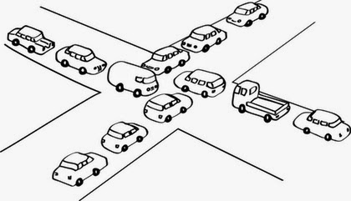
Deadlock
Concurrent Programming CT074-3-2 Version 0418

Slide 35
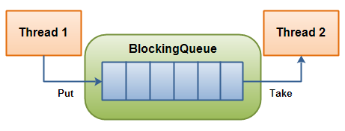
BlockingQueue
A BlockingQueue is typically used to have one thread produce objects, which another thread consumes.

Slide 36
Topic & Structure of The Lesson
Deadlock

Slide 37
Learning Outcomes
At the end of this module, you should be able to do the following:
Identify necessary and sufficient conditions for deadlock.
Identify strategies for dealing with deadlock
Tracing blocked threads in Java

Slide 38
Key Terms You Must Be Able To Use
If you have mastered this topic, you should be able to use the following terms correctly in your assignments and exams:
Deadlock

Slide 39
Deadlock
Concepts: system deadlock: no further progress
four necessary & sufficient conditions
Models: deadlock - no eligible actions
Practice: blocked threads
Aim: deadlock avoidance - to design systems where deadlock cannot occur.

Slide 40
Starvation-freedom
Whatever the process p, each invocation of acquire_mutex() issued by p eventually terminates.

Slide 41
Deadlock-freedom
Whatever the time τ , if before τ one or several processes have invoked the operation acquire_mutex() and none of them has terminated its invocation at time τ , then there is a time τ’ > τ at which a process that has invoked acquire_mutex() terminates its invocation.

Slide 42
Deadlock: four necessary and sufficient conditions
Serially reusable resources:
the processes involved share resources which they use under mutual exclusion.
Incremental acquisition:
processes hold on to resources already allocated to them while waiting to acquire additional resources.

Slide 43
Deadlock: four necessary and sufficient conditions
No pre-emption:
once acquired by a process, resources cannot be pre-empted (forcibly withdrawn) but are only released voluntarily.
Wait-for cycle:
a circular chain (or cycle) of processes exists such that each process holds a resource which its successor in the cycle is waiting to acquire.

Slide 44
Wait-for cycle
Has A awaits B
A
Has E awaits A
E
B
Has B awaits C
D
C
Has C awaits D
Has D awaits E

Slide 45
In Class Discussion
Discuss if the following could exhibit one or more conditions for deadlock:
Ornamental Garden Problem
Cark Park Problem
Notes:
Serially reusable resource – the counter
Serially reusable resource - spaces

Slide 46
Deadlock analysis – Case Study (Printer-Scanner Problem)
Case Study:
Two processes, P and Q, perform the same task, that of scanning a document and printing it by using a shared printer and shared scanner. Each process acquires both the printer and the scanner, performs the scanning and printing and then releases the scanner and printer resources.

Slide 47
Deadlock analysis – Case Study
P acquires the printer first and Q acquires the scanner first. The system satisfies the four necessary conditions for deadlock.
Serially reusable resources
Incremental acquisition
No preemption
Wait-for cycle
Why?

Slide 48
Dining Philosophers Problem
Five philosophers sit around a circular table. Each philosopher spends his life alternately thinking and eating. In the centre of the table is a large bowl of spaghetti. A philosopher needs two forks to eat a helping of spaghetti.
3
2
2
3
1
4
1
4
0
One fork is placed between each
pair of philosophers and they agree that each will only use the fork to his immediate right and left.
0
http://wwwhomes.doc.ic.ac.uk/~jnm/book/book_applets/concurrency.html

Slide 49
The Dining Philosophers system can now be described by the composition of five fork processes and five philosopher processes

Slide 50
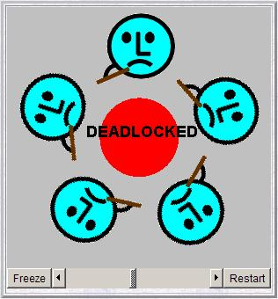
Dining Philosophers - model analysis
This is the situation where all the philosophers become hungry at the same time, sit down at the table and each philosopher picks up the fork to his right.
The system can make no further progress since each philosopher is waiting for a fork held by his neighbor i.e. a wait-for cycle exists!

Slide 51
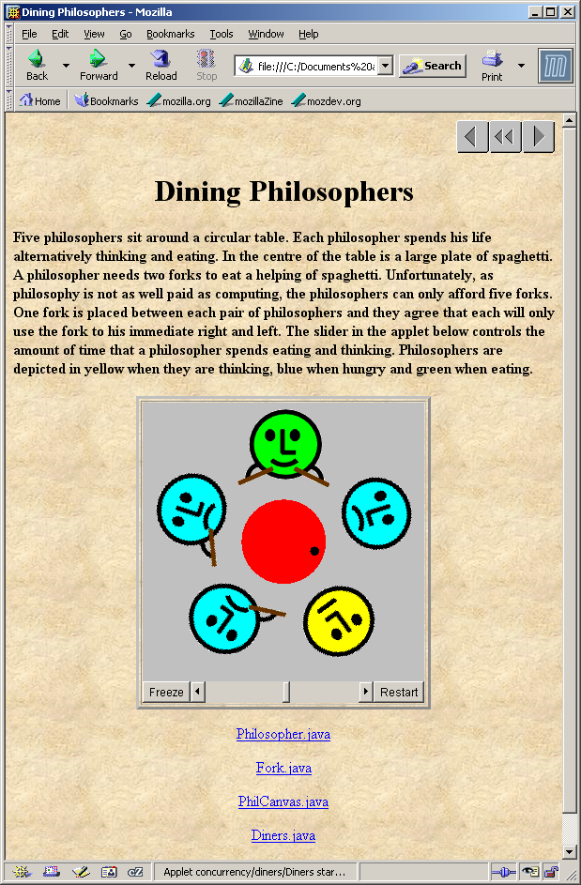
Dining Philosophers
Deadlock is easily detected in our model.
How easy is it to detect a potential deadlock in an implementation – i.e. in your CCP assignment?

Slide 52
Dining Philosophers - implementation in Java
While deadlock can be easily detected in a model, it is not so apparent in the running program which corresponds to that model.
In translating the Dining Philosophers model into an implementation, we must consider which processes in the model will be represented by passive objects (monitors) and which by active objects (threads).
Forks are the passive entities and philosophers are the active entities in the system.

Slide 53
Dining Philosophers - implementation in Java
philosophers: active entities - implement as threads
forks: shared passive entities - implement as monitors
display

Slide 54
Dining Philosophers - Fork monitor
class Fork {
private boolean taken=false;
private PhilCanvas display;
private int identity;
Fork(PhilCanvas disp, int id)
{ display = disp; identity = id;}
synchronized void put() {
taken=false;
display.setFork(identity,taken);
notify();
}
synchronized void get()
throws java.lang.InterruptedException {
while (taken) wait();
taken=true;
display.setFork(identity,taken);
}
}
taken encodes the state of the fork

Slide 55
Dining Philosophers - Philosopher implementation
class Philosopher extends Thread {
...
public void run() {
try {
while (true) { // thinking
view.setPhil(identity,view.THINKING);
sleep(controller.sleepTime()); // hungry
view.setPhil(identity,view.HUNGRY);
right.get(); // gotright chopstick
view.setPhil(identity,view.GOTRIGHT);
sleep(500);
left.get(); // eating
view.setPhil(identity,view.EATING);
sleep(controller.eatTime());
right.put();
left.put();
}
} catch (java.lang.InterruptedException e){}
}
}
Follows from the model (sitting down and leaving the table have been omitted).

Slide 56
Dining Philosophers - implementation in Java
Code to create the philosopher threads and fork monitors:
for (int i =0; i<N; ++i)
fork[i] = new Fork(display,i);
for (int i =0; i<N; ++i){
phil[i] =
new Philosopher
(this,i,fork[(i-1+N)%N],fork[i]);
phil[i].start();
}

Slide 57
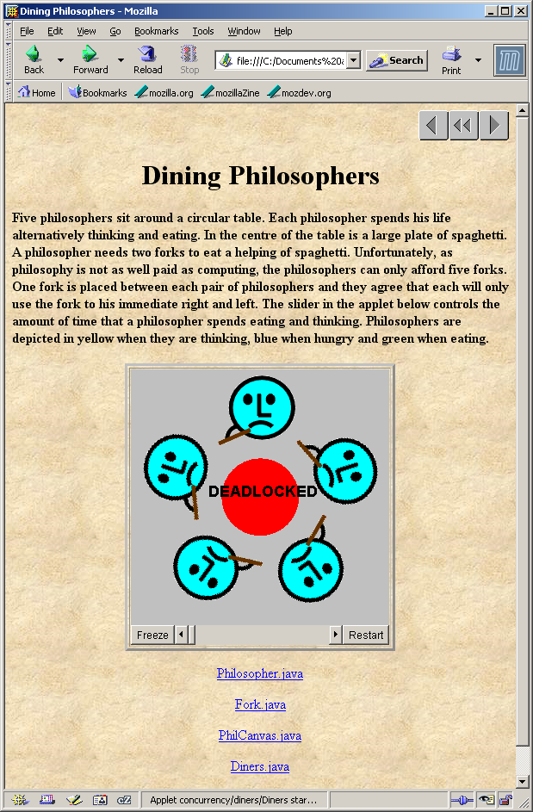
Dining Philosophers
To ensure deadlock occurs eventually, the slider control may be moved to the left. This reduces the time each philosopher spends thinking and eating.
This "speedup" increases the probability of deadlock occurring.

Slide 58
Deadlock-free Philosophers
Deadlock can be avoided by ensuring that a wait-for cycle cannot exist. How?
Introduce an asymmetry into our definition of philosophers.
Use the identity I of a philosopher to make even numbered philosophers get their left forks first, odd their right first.
Other strategies?
Notes:
When a philosopher wants to eat, he/she checks both chopsticks. If they are free, then he/she eats. Otherwise, he/she waits on a condition variable. Whenever a philosopher finishes eating, he/she checks to see if his neighbors want to eat and are waiting. If so, then he/she calls signal on their condition variables so that they can recheck the chopsticks and eat if possible.

Slide 59

Other strategies
When a philosopher wants to eat, he/she checks both chopsticks. If they are free, then he/she eats. Otherwise, he/she waits on a condition variable.

Slide 60
Other strategies
Whenever a philosopher finishes eating, he/she checks to see if his neighbors want to eat and are waiting. If so, then he/she calls signal on their condition variables so that they can recheck the chopsticks and eat if possible.
And many more…..

Slide 61
Summary
Concepts
deadlock: no further progress
four necessary and sufficient conditions:
serially reusable resources
incremental acquisition
no pre-emption
wait-for cycle
Practice
blocked threads

Slide 62
References
Jeff M & Jeff K, Concurrency – State Models & Java Programming

Slide 63
Q & A

Slide 64
What we will cover next
Safety

